Slide 1
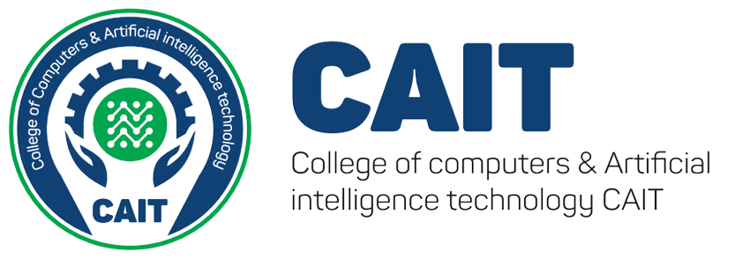





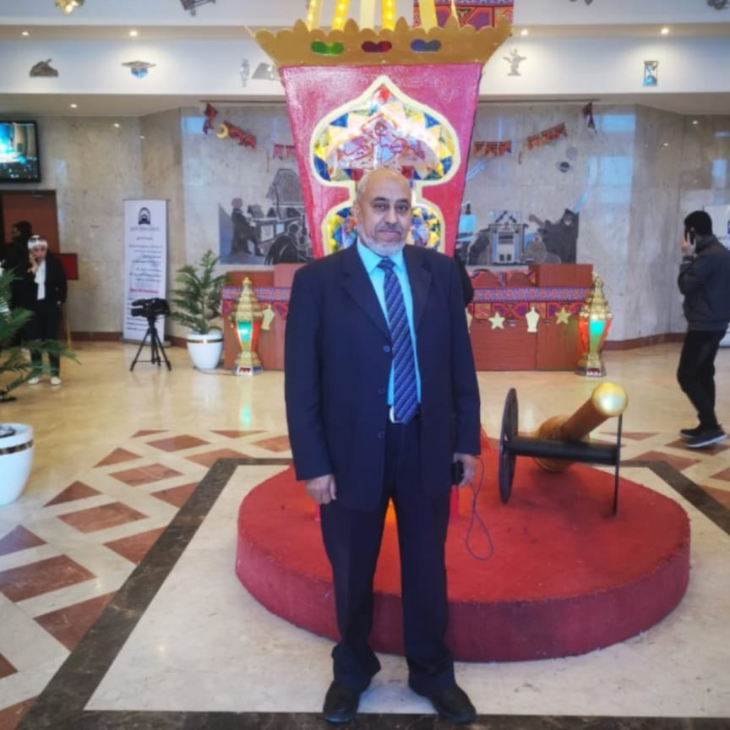
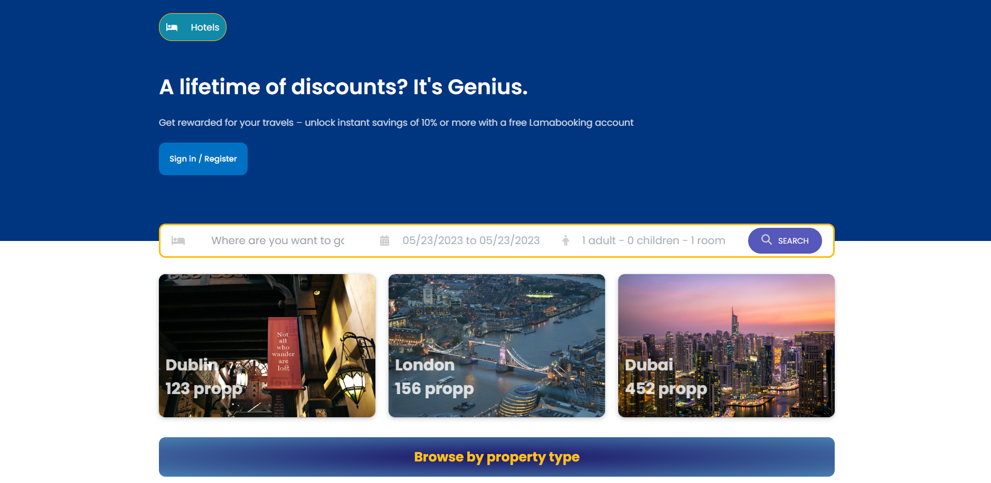
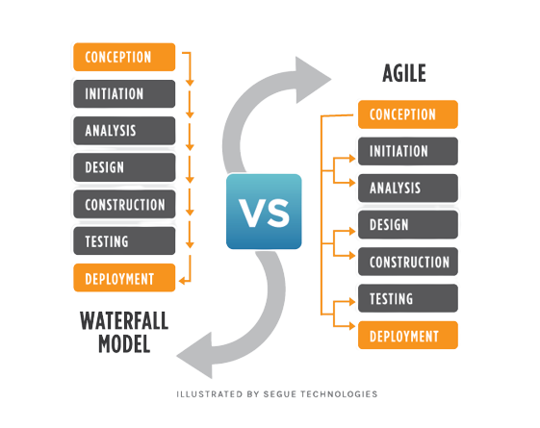
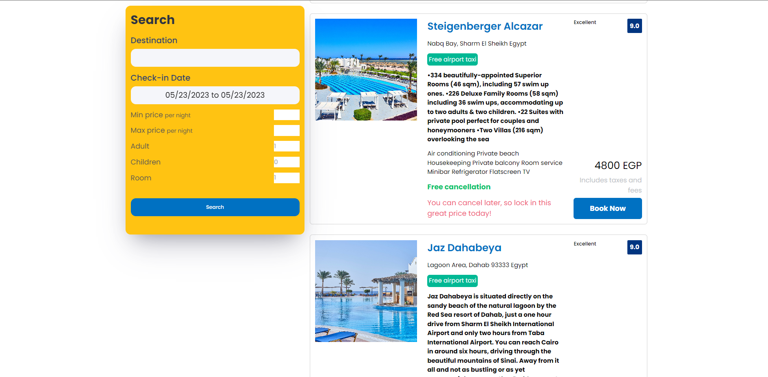
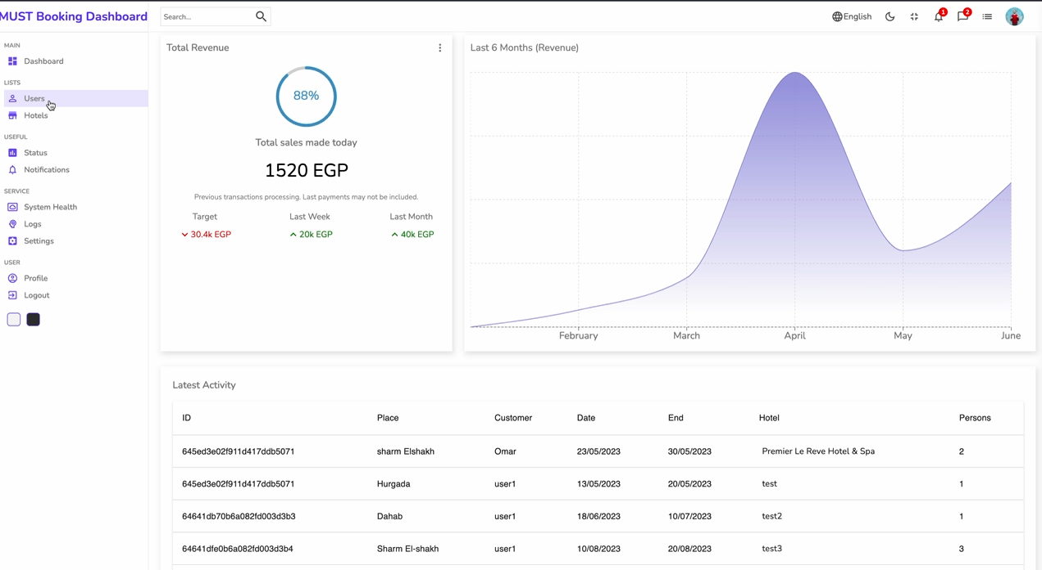
Hotel Reservation System
Teaching Assistants:
Eng. Aya Mahmoud
Eng. Mai Assem
Mahmoud Hamza
77876
Hamdy Mohamed
89455
Omar Mohamed
89471
Ayham Ahmed
77660
Under supervision of Professor DR. Esmat Mohamed
Abstract
Methodology
Expected Outcomes
This project aims to develop a comprehensive hotel booking website that provides users with a seamless and user-friendly experience. The website will allow users to search for hotels, compare prices, and make reservations. The project will involve extensive market research to identify the major players in the hotel booking industry and to understand user needs and preferences. The website will be designed with a focus on usability and user experience, with intuitive navigation, responsive design, and fast loading times. The website will also integrate with third-party systems, such as payment gateways and hotel management systems
Agile model is an iterative approach to project management and software development that helps teams deliver value faster and with fewer headaches. Requirements, plans, and results are evaluated continuously to create a natural mechanism for responding to change quickly.
Hotel Booking System that simplifies the booking process, enhances communication and efficiency, and provides an improved experience for both hotel administrators and users, ultimately leading to increased customer satisfaction and improved operational effectiveness.
Recommendations for optimizing a hotel booking website for search engines and improving its visibility in search results.
Why do we prefer Agile over Waterfall model?
Agile model and Waterfall model are two popular project management methods that are best suited for different types of projects. Waterfall requires the team to complete each project phase before moving on to the next one, while Agile encourages the team to work simultaneously on different phases of the project.
Results
Introduction
The advancement of technology has revolutionized various industries, including the hospitality sector. The convenience and ease of online booking systems have become a necessity for hotels to effectively manage their operations and attract customers. In line with this, our graduation project aims to develop a comprehensive Hotel Booking System that caters to the needs of both hotel administrators and users.
The Hotel Booking System is designed to streamline the hotel reservation process and provide a user-friendly platform for customers to browse and book hotel offers, while enabling administrators to manage hotel listings and handle user reservations efficiently.
Objectives
Acknowledgment
To create an easy-to-use interface for hotel administrators to add and update hotel offers, manage reservations, and oversee the booking process effectively.
To develop a user-friendly interface for customers to browse through hotel offers, make reservations, view their booking history, and access their profiles.
To implement a robust and secure database system that stores hotel information, user details, and reservation data securely.
To integrate a reliable payment gateway to facilitate secure and convenient transactions for users.
To ensure seamless communication and notification mechanisms between hotel administrators and users regarding reservation confirmations, updates, and cancellations.
To optimize the system's performance, scalability, and responsiveness to handle multiple users and simultaneous reservations efficiently.
To conduct thorough testing and debugging to ensure the system's reliability, security, and user-friendliness.
We would like to express our sincere gratitude and appreciationto Dr. Esmat for his invaluable guidance and support throughout the course of this research project. Dr. Esmat’s expertise and insights were instrumental in shaping the direction of this project and ensuring its success. Dr. Esmat's unwavering support and encouragement provided us with the motivation and inspiration to overcome the challenges that arose during the course of this project. His willingness to provide feedback and guidance at every stage of the project was instrumental in helping us to refine our ideas and produce a high-quality research paper. We would also like to thank Dr. Esmat for his continued support and mentorship, which has been invaluable throughout our academic career. His dedication to teaching and research has been an inspiration to us, and we feel privileged to have had the opportunity to work with him.Once again, we would like to express our deep gratitude and appreciation to Dr. Esmat for his guidance and support throughout this project. His contributions have been in valuable, and we are grateful for the opportunity to have worked with him.
Conclusion
In conclusion, the hotel booking project represents a significant step forward in the digitalization of the hospitality industry. By providing a user-friendly platform for customers to browse and book hotel rooms, the project streamlines the booking process and improves the overall customer experience.
The project also offers a range of benefits for hotel owners and managers, including automated booking management and the ability to reach a wider audience of potential customers. The project's use of modern technologies and best practices ensures that it is scalable, secure, and easy to maintain.
Overall, the hotel booking project represents a valuable contribution to the hospitality industry, both in terms of improving the customer experience and helping hotels to operate more efficiently. As the project continues to evolve and improve, it has the potential to become an essential tool for hotels of all sizes and types..

